Slide 1


Guru Gobind Singh College of Engineering & Research Centre Nashik, Maharashtra, India
12.09.2025 FRIDAY
E-Pluse
Automated Attendance System for Rural Schools

Slide 2


SMART INDIA HACKATHON 2025
AI-Powered ERP System for Rural Schools
Problem Statement ID - SIH25012
Problem Statement Title - Automated Attendance System for Rural Schools
Theme - Smart Education
PS Category - Software
Team ID -
Team Name - E-Pluse

Slide 3
AI-Powered ERP for Rural Schools
E-Pluse
Proposed Solution:-
Centralized ERP platform tailored for rural schools.
Works offline-first with data sync when internet is available.
Smart attendance through Face Recognition , RFID Cards or QR.
Unified dashboard for teachers, students, admins, and parents.
Integrated modules for attendance, academics, scholarships, and mid-day meals.
Uniqueness & Innovation:-
Offline + Cloud Hybrid → Works seamlessly without stable internet.
AI-Powered Analytics → Face recognition, predict dropouts, absenteeism trends.
Low-cost hardware integration → QR/RFID/face recognition.
Scalable solution → Deployable across multiple schools.

Slide 4
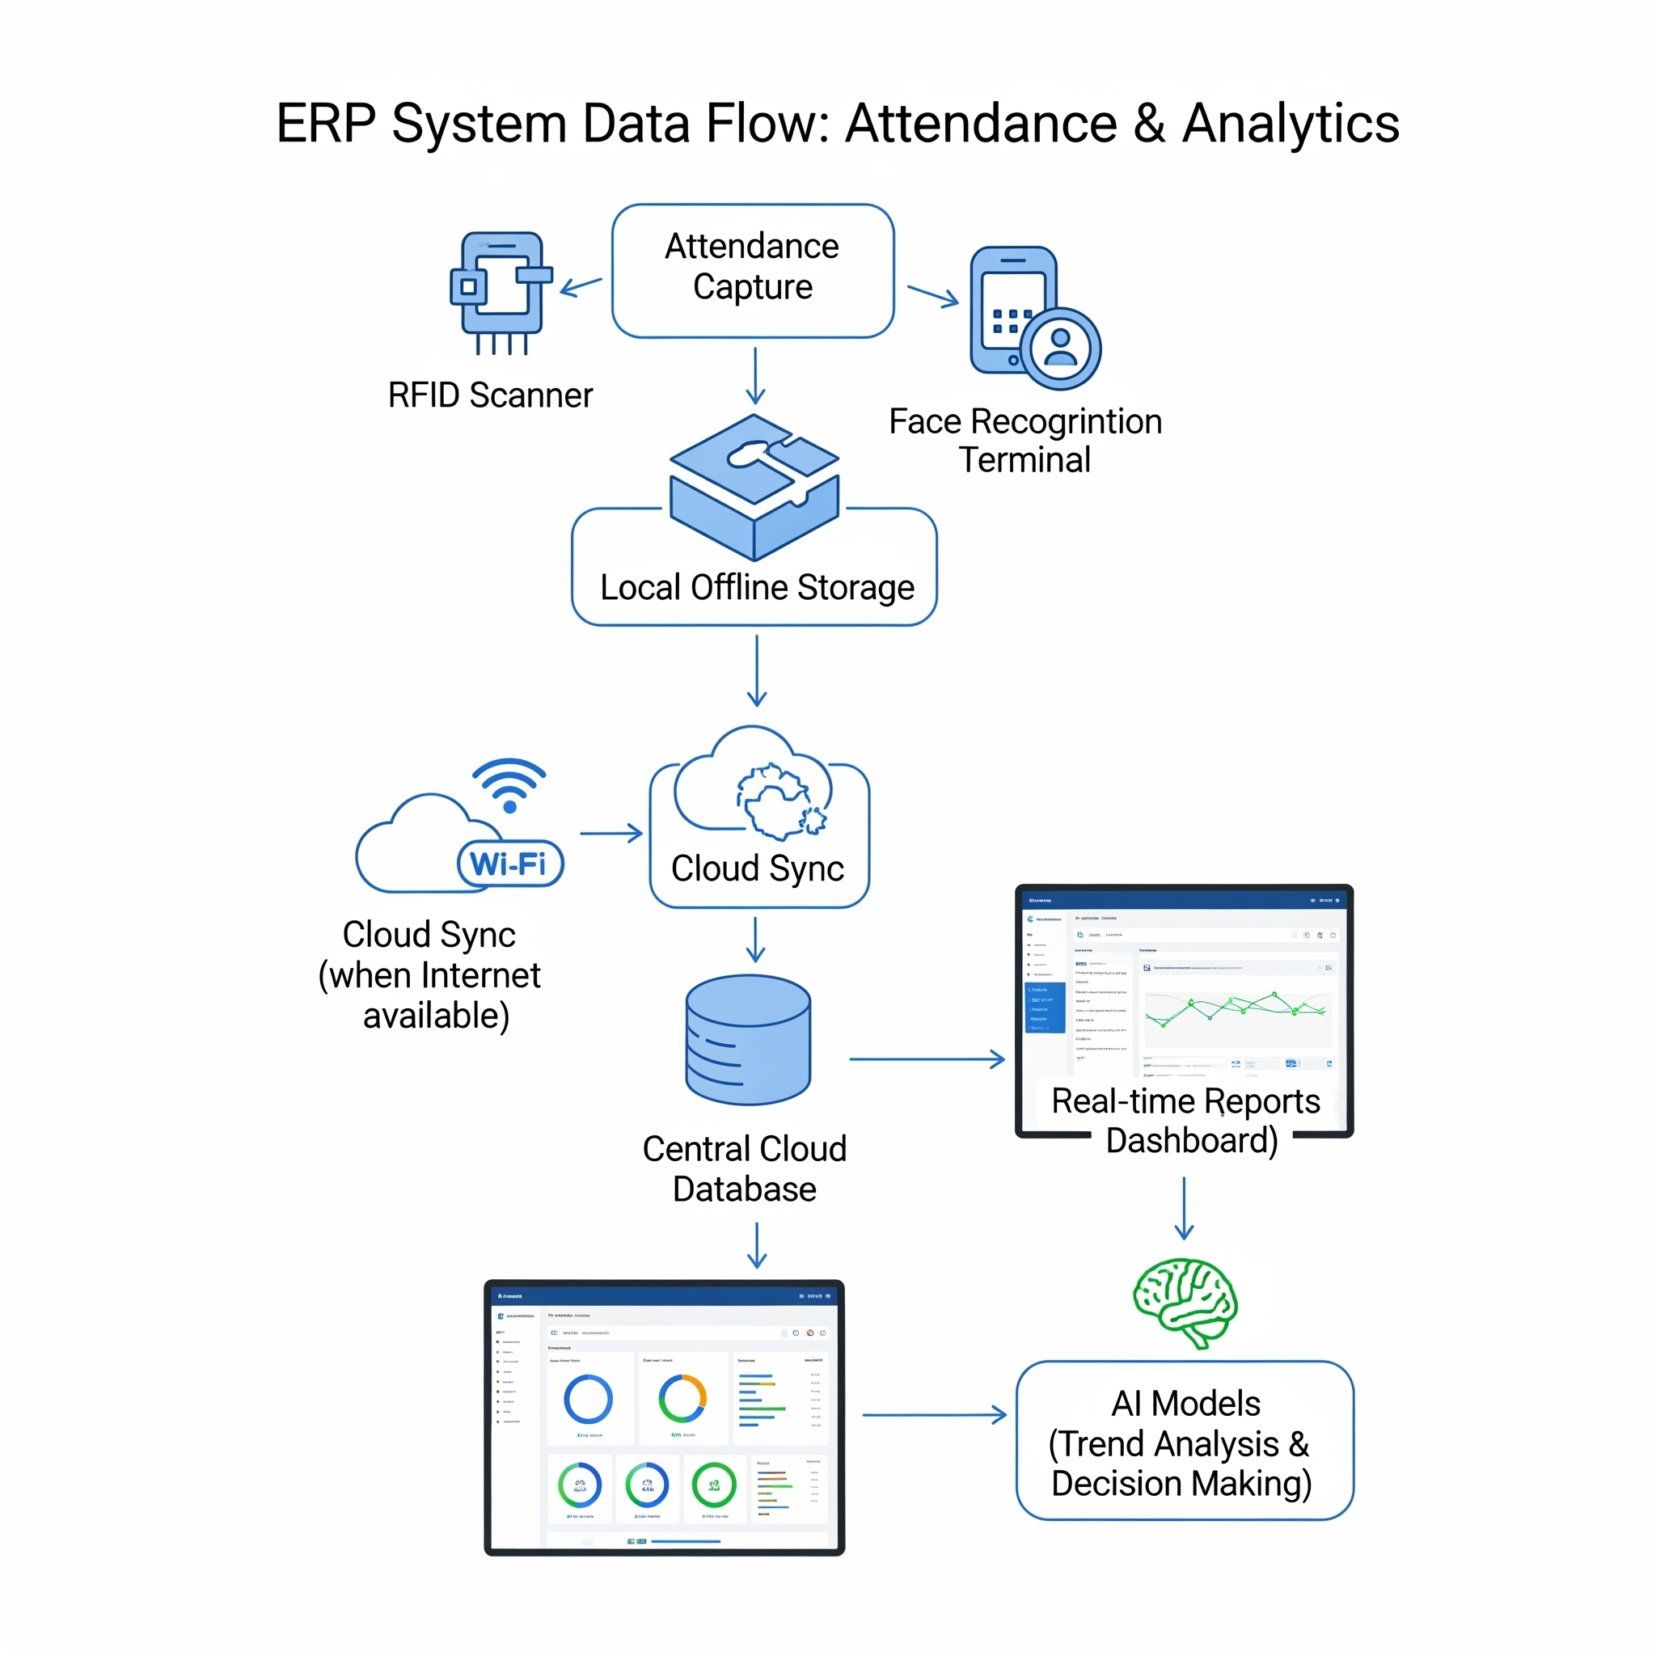
TECHNICAL APPROACH
E-Pluse
Technologies::-
Frontend: ReactJS / Flutter (Mobile App)
Backend: Python (Flask/Django)
Database: SQLite (Offline), PostgreSQL/MySQL (Cloud)
AI: OpenCV for face recognition, TensorFlow Lite for edge AI
Hardware: RFID readers, QR scanners

Slide 5
FEASIBILITY AND VIABILITY
E-Pluse
Feasibility:-
Low-cost implementation using open-source software.
Scalable architecture for multiple schools.
Minimal training required for teachers.
Challenges:-
Initial resistance to adopting new tech.
Strategies to Overcome:-
Simple UI in local languages for ease of use.

Slide 6
IMPACT AND BENEFITS
E-Pluse
Impact on Rural Schools :-
Accurate, tamper-proof attendance tracking.
Transparent reporting for government schemes (mid-day meals, scholarships).
Data-driven decisions for resource allocation.
Benefits:-
Social: Increased student retention and engagement.
Economic: Reduced administrative costs and manual work.
Environmental: Digital records reduce paper usage.

Slide 7
RESEARCH AND REFERENCES
E-Pluse
Research Sources:-
Leveraging Artificial Intelligence for Rural Education → https://www.preprints.org/manuscript/202504.0598/v1
Artificial Intelligence and Data Literacy in Rural Schools’ Teaching Practices → https://www.mdpi.com/2227-7102/15/3/352
Offline-first Architecture for Education Systems in Low-connectivity Areas → https://unesdoc.unesco.org/ark:/48223/pf0000385077

